Slide 1
Strength of Materials
Module 7
(Column & Pressure Vessels)
Dr. G.Venkatachalam
Professor / SMEC
VIT Chennai Campus
Chennai

Slide 2
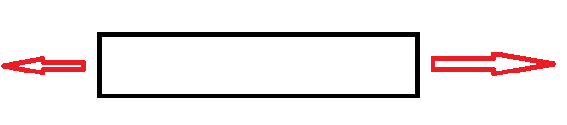
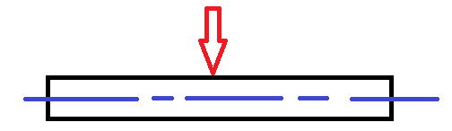
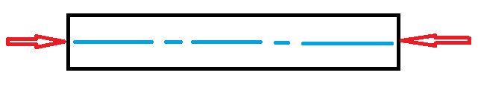
Bar
Beam
Column

Slide 3


Slide 4
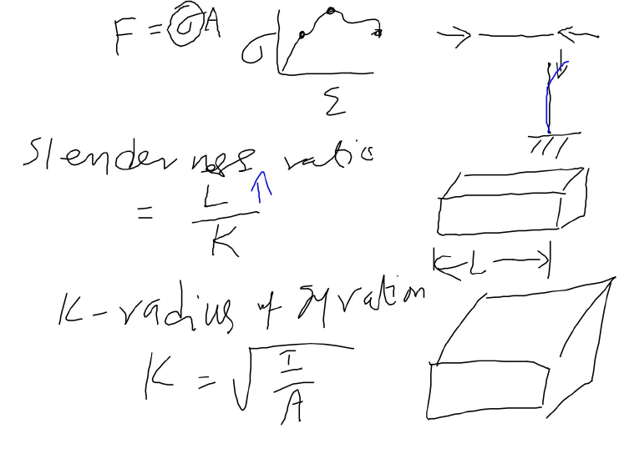
Column – structure subjected to compression
Pole vault stick when athlete grounds it
I – moment of inertia;
A – area of cross section

Slide 5
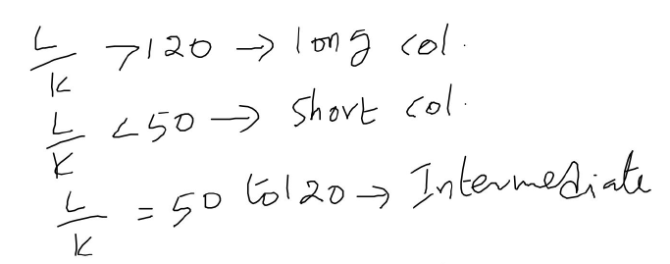
Why such divisions are required?

Slide 6
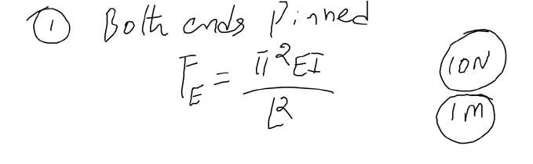
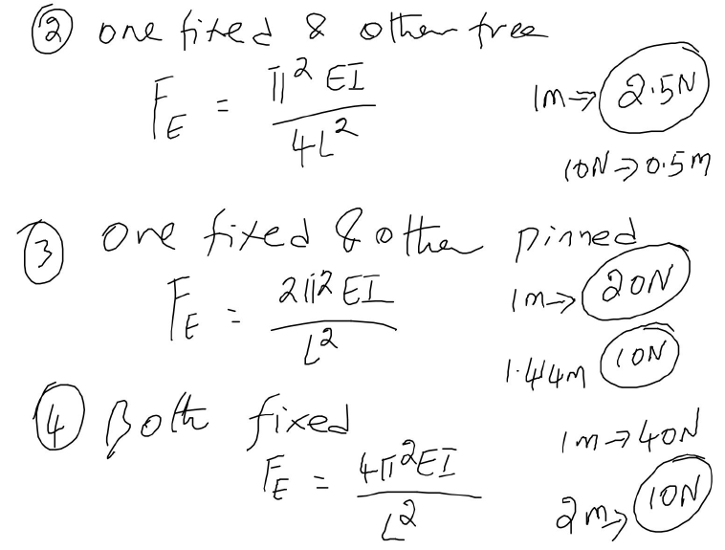
Buckling load (Euler’s formula) – for different end conditions – He says “if this criteria is met, column will buckle. Buckling is an undesirable phenomena.

Slide 7
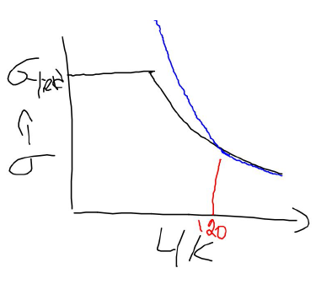
Comparison of Euler & experiment
Experimental values
Euler prediction
Euler formula is good only for long columns. How short column & intermediate columns are dealt??

Slide 8
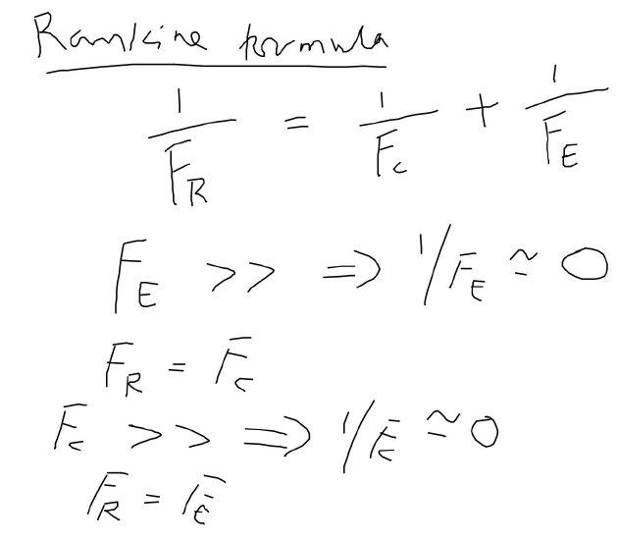
F_{R} – Rankine load;
F_{C} – Compressive load;
F_{E} – Euler’s load
Short column to buckle – high buckling load is required.
Long column to compress – high compressive load is required.

Slide 9
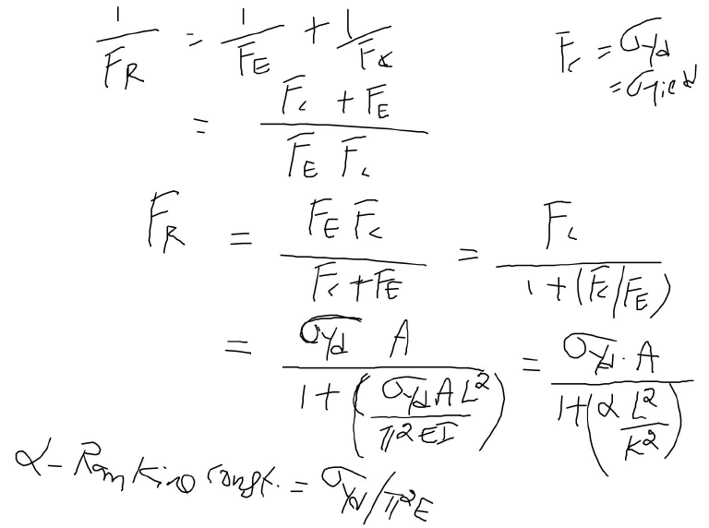
For intermediate column, both compression & buckling effects are included.
Suitable changes are to be made according to the end conditions in F_{E} substitution.

Slide 10
Tutorials

Slide 11
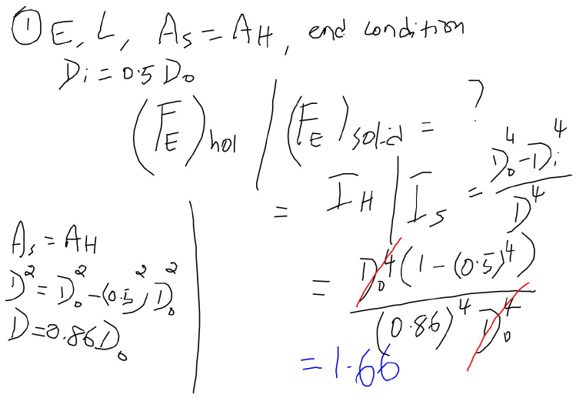
Advantages of using hollow circular column over solid circular column.

Slide 12
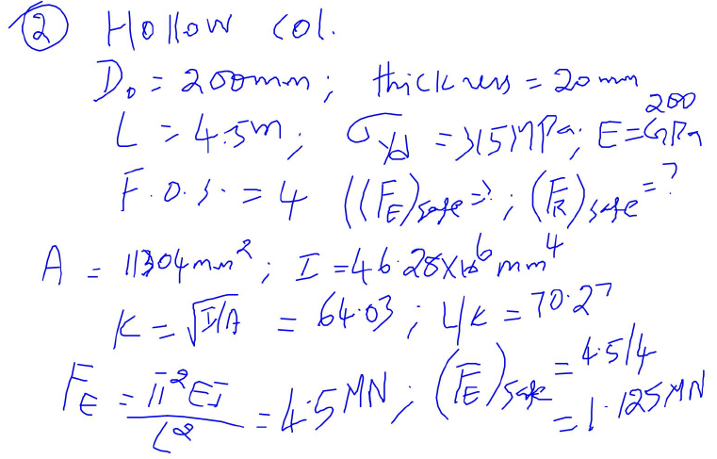

Slide 13
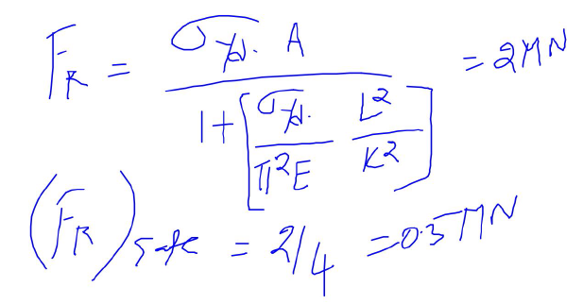
Euler formula prediction (1.125 kN) is higher than the Rankine formula (0.5 kN) – L/K ratio must be checked.

Slide 14
Pressure Vessels

Slide 15
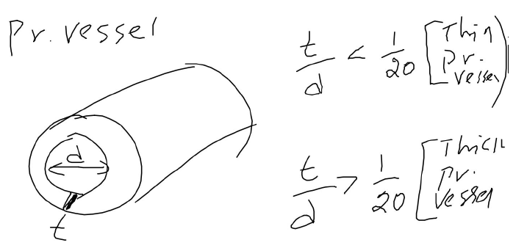
Why do we need to classify thin cylinder and thick cylinder???

Slide 16
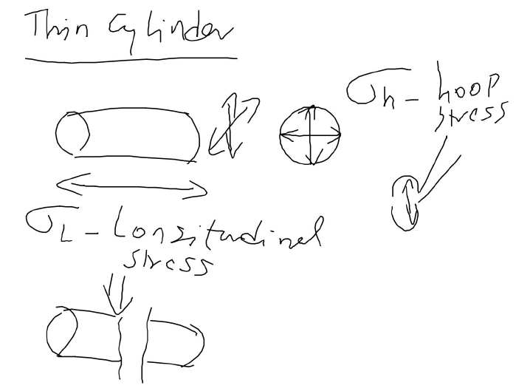
Due to critical σ_{h}, cylinder is broken in to 2 (or more) hemispheres.
Due to critical σ_{L}, cylinder is broken in to 2 (or more) cylinders.

Slide 17
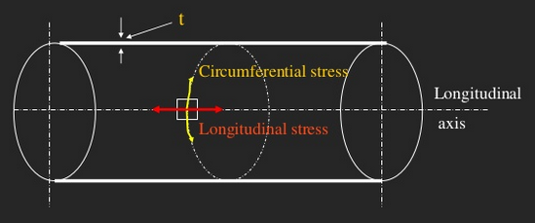

Slide 18
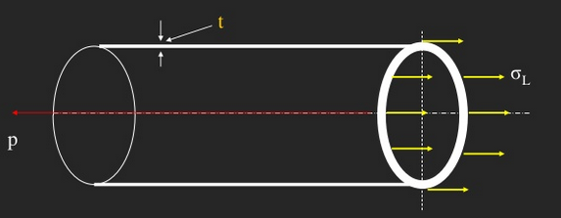

Slide 19
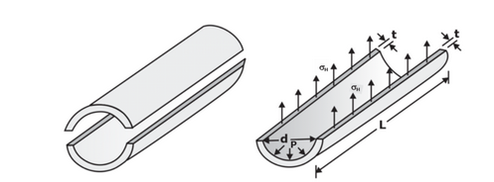

Slide 20
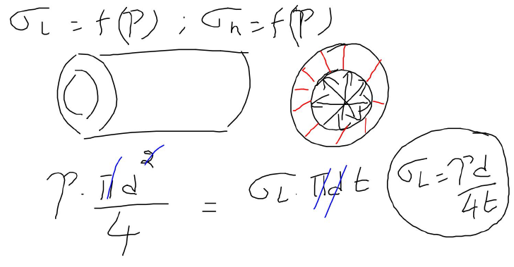
ΣF = 0 is used; Force due to fluid pressure = force due to internal resistance
P – fluid pressure
Force due to fluid pressure
Force due to internal resistance

Slide 21
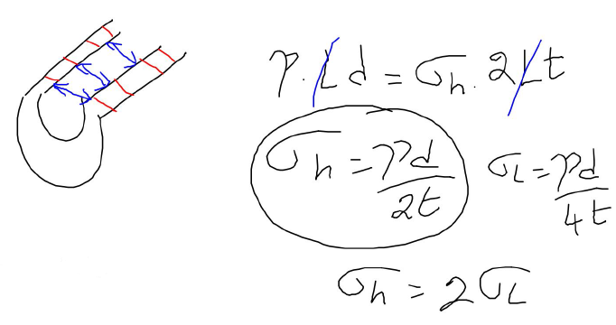
Same approach mentioned in previous slide is extended here
Inferences??

Slide 22
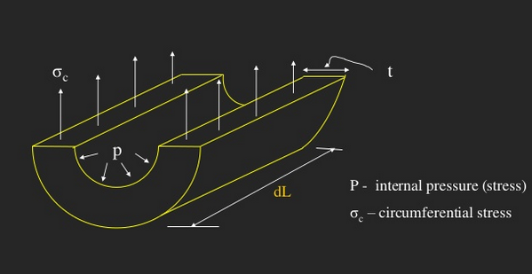

Slide 23
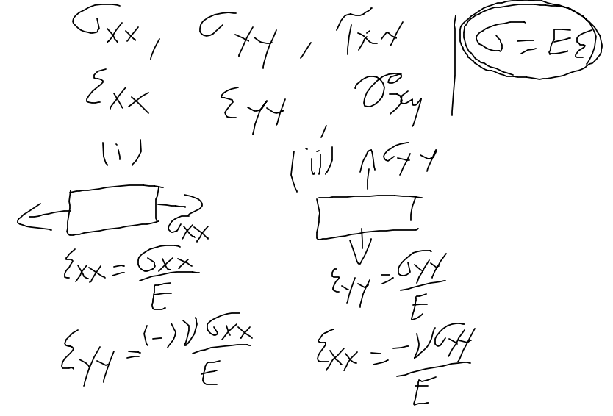
Bi-axial state of strain – to find Δd & ΔL

Slide 24
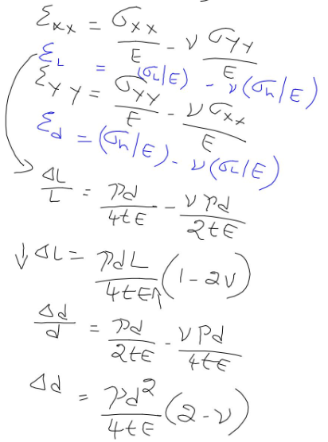
To find Δd & ΔL – why it is required to be found out??

Slide 25
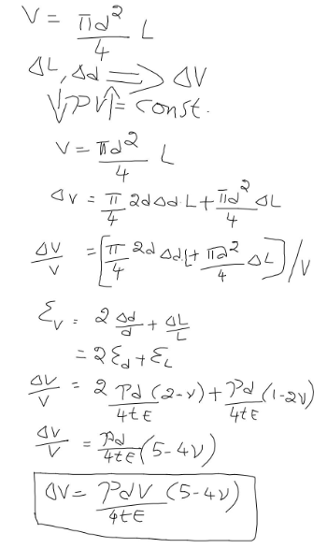

Slide 26
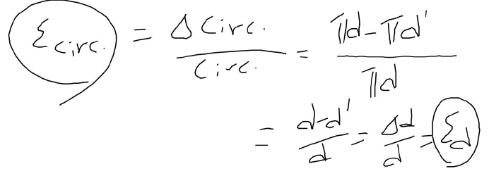

Slide 27
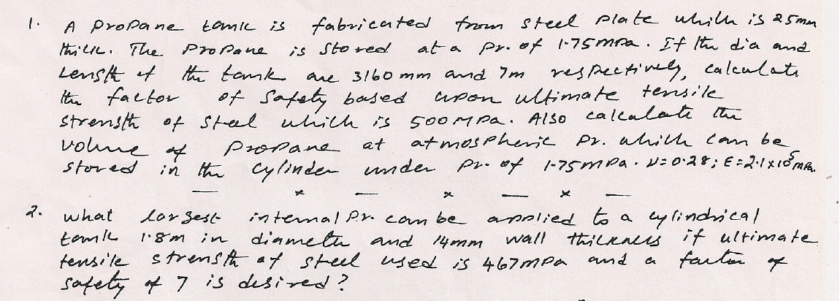
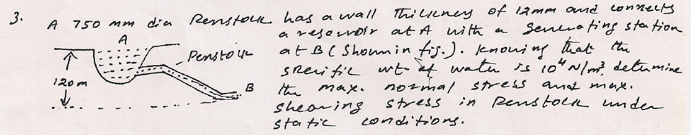

Slide 28
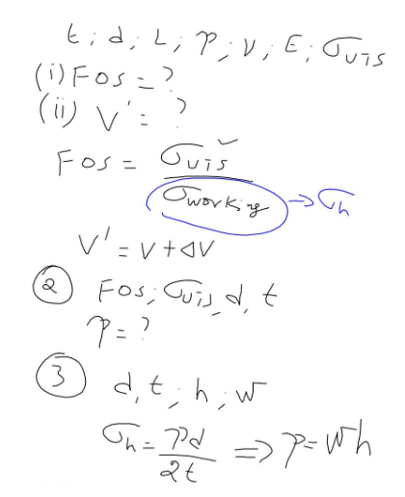

Slide 29
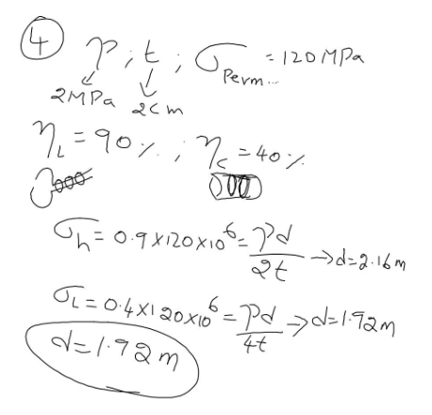
A boiler is subjected to an internal steam pressure of 2 N/mm². The thickness of boiler plate is 2.0 cm and permissible tensile stress is 120 N/mm². Find out the maximum diameter, when the efficiency of longitudinal joint is 90 % and circumference joint is 40 %.

Slide 30
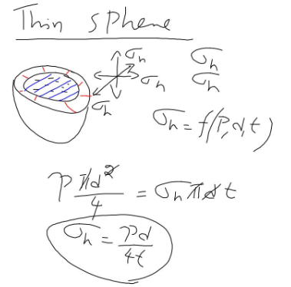
Here there is only hoop stress

Slide 31
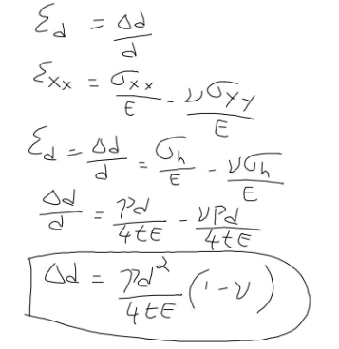

Slide 32
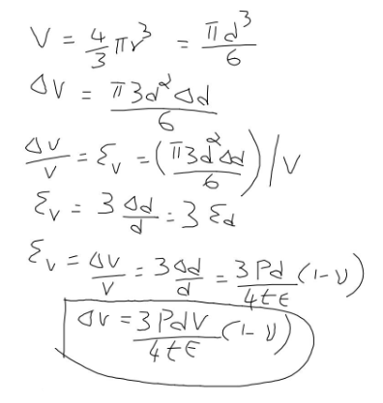
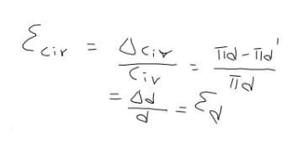

Slide 33
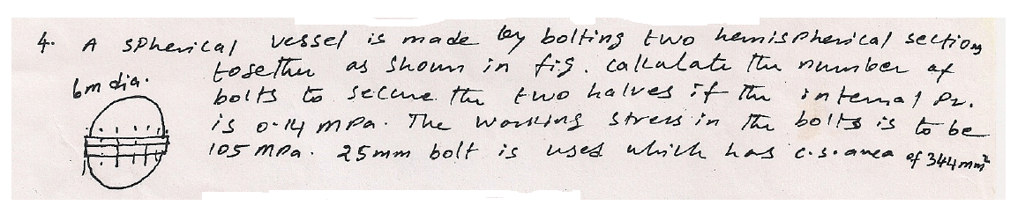
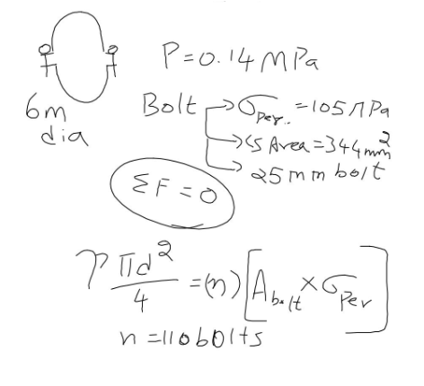

Slide 34
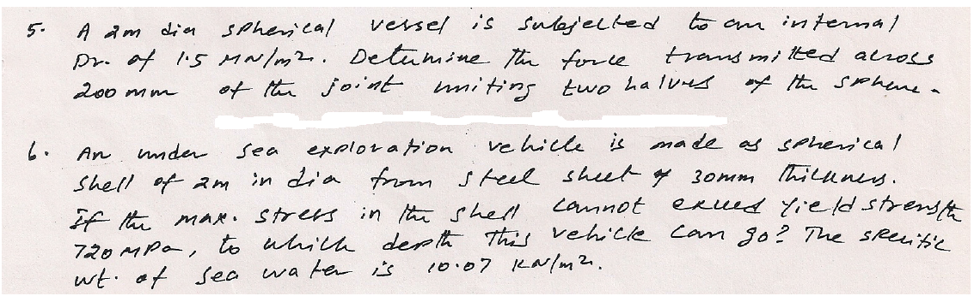
5. 150 kN;
6. 4290 m

Slide 35
Thank You

